Slide 1

Present Perfect
Voltooid tegenwoordige tijd

Slide 2
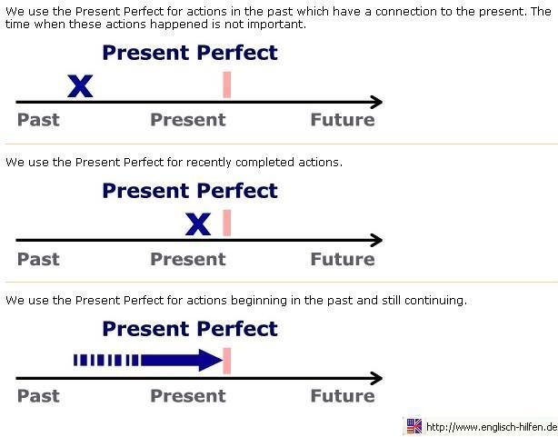
When to use it
When something happened in the past, but it is not important when it happened
Examples:
I have visited South America.
We have gone to secondary school.
She has called her brother.

Slide 3
When to use it
When something started in the past and is still going on
Examples:
We have lived here since 2001.
I haven’t been to grandma for two weeks.
He has waited at the bus stop for three hours.

Slide 4
Keywords
Aan bepaalde woorden kun je ‘zien’ dat je de Present Perfect moet gebruiken. Enkele daarvan zijn samen te vatten in ‘fyne jas’.
Fyne jas = For Yet Never Ever
Just Already (always) Since
Als er helemaal geen tijdsaanduiding in de zin staat is het vaak een Present Perfect!

Slide 5

Form +
Affirmative
Subject + have / has + past participle
Examples:
The meeting has already started.
He has gone to visit his friend.
They have watched that film.
Third row of
irregular verbs list

Slide 6

Form -
Negative
Subject + haven’t / hasn’t + past participle
Examples:
I haven’t seen him for ages.
He hasn’t visited his grandmother.
The teacher hasn’t arrived yet.
Third row of
irregular verbs list

Slide 7

Form ?
Questions
have / has + subject + past participle
Examples:
Have you ever had an operation?
What have you done to your hair?
Has the postman been yet?
Third row of
irregular verbs list

Slide 8
Extra practise
http://www.ego4u.com/en/cram-up/grammar/present-perfect-simple/exercises
http://www.englisch-hilfen.de/en/exercises/tenses/present_perfect_statements.htm
http://www.really-learn-english.com/present-perfect-exercises.html#01
http://www.eslgamesplus.com/have-ever-present-perfect-moonshot/

